Slide 1

Introduction and Capabilities Review
Deceris LLC
13284 Osage Drive
Woodbridge, VA 22193
703-861-5708

Slide 2

Table of Contents
Our Mission
Core Competencies
Clients
Customer Partnership
Service Offerings
Management
Corporate Information
Contact Us
A Service Disabled Veteran Owned Disadvantaged Small Business

Slide 3
Mission Statement
Our goal is to integrate our Federal clients’ current human capital, process, strategy and technology into effective solutions that meet all mission requirements with a commitment to outstanding client service, open communication and the growth and development of our employees
A Service Disabled Veteran Owned Disadvantaged Small Business

Slide 4
Core Competencies
We provide our clients with Consulting and Support Services in the following areas:
Privacy
Project Management
Program Planning
Information Technology
Knowledge Management
Records and Document Management
Hardware Acquisition & Acquisition Planning
Information Assurance and Cyber Security Services
Business Consulting
Training
A Service Disabled Veteran Owned Disadvantaged Small Business

Slide 5




Among our Clients
UNITED STATES AIR FORCE
United States Department of Labor
US ARMY MEDICAL SERVICE
VETERANS AFFAIRS
A Service Disabled Veteran Owned Disadvantaged Small Business

Slide 6
Customer Partnership
We partner with you to improve your business:
We go above and beyond to look for the opportunities to save you money, improve your operational efficiency, and leverage newer technologies to improve customer service
Success breeds long-term relationships
A Service Disabled Veteran Owned Disadvantaged Small Business

Slide 7
Technology Solutions
Specific IT Services that support our Core Competencies:
Privacy
Records Management
Documentation Management
IT Strategic Planning
Information Security
Intranet and Internet Solutions
Sharepoint design and implementation
Systems and Integration Engineering Application and Web Development
Training
A Service Disabled Veteran Owned Disadvantaged Small Business

Slide 8
Records Management Services
Our Records Management Services include:
Records Management Support
Freedom of Information Act
Directives Management
Paperwork Reduction Act
Conduct Records Management and FOIA Audits
Conduct FOIA and Records Management Training
A Service Disabled Veteran Owned Disadvantaged Small Business

Slide 9
Privacy Services
Deceris’ Team of Privacy experts is familiar with M-03-22.
We understand that a Privacy Impact Assessment (PIA) is an analysis of how information is handled to ensure that it conforms to the applicable legal, regulatory, and policy requirements
Deceris understands that mitigating potential privacy risks requires:
Determining the risks and effects of collecting, maintaining and disseminating information in an identifiable form, and
Examining and evaluating protections and alternative processes for handling the information
Deceris knows that the E-Government Act requires agencies to conduct a PIA before:
Developing or procuring IT systems or projects that collect, maintain or disseminate information in identifiable form from or about members of the public; or
Initiating a new electronic collection of information in identifiable form; or
Where a system change creates new privacy risks; and
That no PIA is required if information relates to internal government operations, has been previously assessed under an evaluation similar to a PIA, or where privacy issues are unchanged.
A Service Disabled Veteran Owned Disadvantaged Small Business

Slide 10
Privacy Requirements
Deceris’ Team of Privacy experts are familiar with:
Privacy Policies on Agency Websites; Privacy Policies in Machine-Readable Formats; Privacy Policies Incorporated by M-03-22;
Agency Privacy Activities/Designation of Responsible Official
Which requires all federal employees and contractors to remain mindful of privacy and their obligation to protect information in identifiable form;
Reporting Requirements and Sec. 208 Privacy Provisions.
Like the officials at the Department of Veterans Affairs we are committed to protecting the privacy of the American people.
Deceris’ Team of Privacy experts are very familiar with the Privacy Act of 1974.
A Service Disabled Veteran Owned Disadvantaged Small Business

Slide 11
Privacy Past Performance
Deceris’ Team of Privacy experts have worked with:
The Department of Veterans Affairs Records Management Program
The Air Force at RAF Mildenhall, England
The White House at the National Security Council, in the Office of Information Policy and Security Review
The CIA, FBI, DoD, Information Security Oversight Office (ISOO),
The National Archives
Many other federal agencies in processing public request under the Freedom of Information Act, Privacy Act and Mandatory Review.
A Service Disabled Veteran Owned Disadvantaged Small Business

Slide 12
Information Assurance and Cybersecurity Services
Our Information Assurance and Cybersecurity Services include:
Certification and Accreditation Services
Information Assurance
Security Audits
Incident Response and Security Operations Center Design and Management
Contingency Planning
Vulnerability Assessments
A Service Disabled Veteran Owned Disadvantaged Small Business

Slide 13
Veteran Administration Solutions
Privacy
FOIA
Web Content Management
Document Repository for knowledge sharing
Electronic Records Management
Email Records Management
Physical Records Management
File Plan Management
Disposition Procession
Security
Compound Records Management
Sophisticated Metadata Management
A Service Disabled Veteran Owned Disadvantaged Small Business

Slide 14
Hardware and Acquisition Planning
Deceris understands the complexity and challenge of effective acquisition planning. Our services include:
Life Cycle Cost Estimating,
Independent Government Estimates;
Estimate at Completion;
Analysis of Alternatives, Gap Analysis
Business Case Analysis, Trade off Analysis
Requirements Analysis, Use Case Modeling
Software Size Assessment, IT Capacity Planning
Hardware Acquisition
Deceris is an Authorized Dell Reseller
A Service Disabled Veteran Owned Disadvantaged Small Business

Slide 15

Our Management
Benjamin F. McEachin, CEO, Deceris LLC
Prior to establishing Deceris, Mr. McEachin led many key client engagements, including work for SAIC, the VA, the Dept of Labor and other corporate clients. McEachin holds a Top Secret Clearance.
Mr. McEachin served as a Security and Facilities Manager at Alion Science Technologies where he was responsible for all aspects of the security and facilities programs.
McEachin's expertise is in designing and building out SCIFs, Closed Areas, DITSCAP C&A process and Records Management Services.
McEachin is a retired Chief Master Sergeant having spent over 26 years in the United States Air Force serving at the White House, Office of Information Security Policy for National Security Council, and the Pentagon.
He holds a M.S. degree in Information Technology from the University of Maryland University College and holds the Chief Information Officer (CIO) certification from the University of Maryland University College and a CIO) certification from the General Services Administration.
A Service Disabled Veteran Owned Disadvantaged Small Business

Slide 16
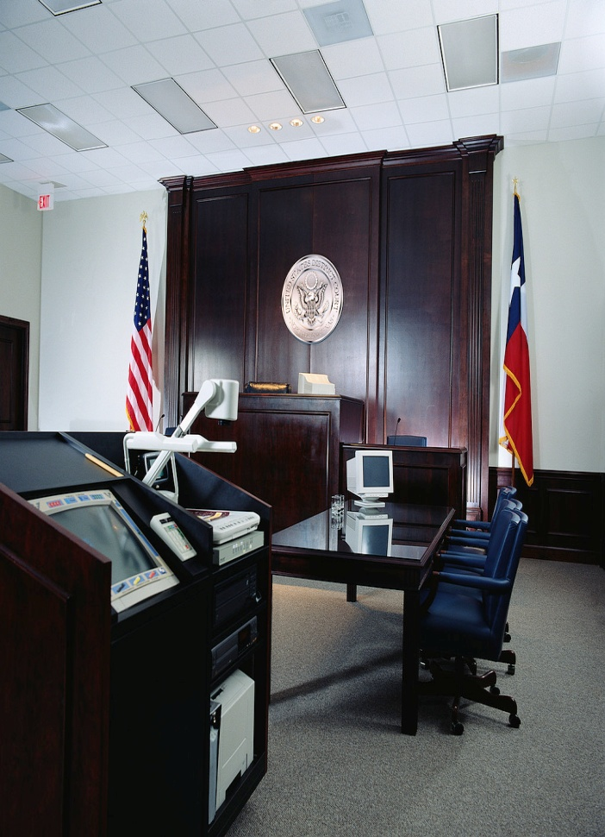
Corporate Information
Duns # 96-276-2477
EIN: 27-2665086
SIC Codes: 8742, 8741
8011, 9111
9451, 9711
NAICS Codes: 514191
514199
541611
561320
611420
621999
921110
A Service Disabled Veteran Owned Disadvantaged Small Business

Slide 17

For More Information
Please contact:
Ben McEachin
Chief Executive Officer
Deceris, LLC
13284 Osage Drive
Woodbridge, VA 22193
703-861-5708
Ben.mceachin@deceris.com
A Service Disabled Veteran Owned Disadvantaged Small Business

